Slide 1
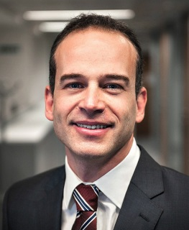
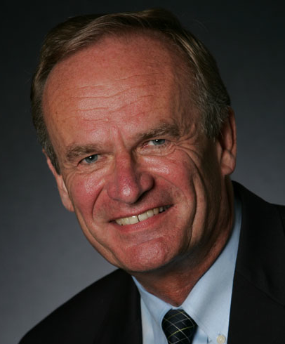
Biases and Debiasing in Risk and Decision Analysis Modelling
Gilberto Montibeller
Dept. of Management, London School of Economics, UK
&
Detlof von Winterfeldt
CREATE, University of Southern California, USA

Slide 2
Approaches to Decision Making Research
Problem Frame
& Structure
Decision
Making
Objectives & Preferences
Content knowledge
Decision Outcomes
Uncertainties & Risks
Options
Decision Process
Normative: how should fully rational decision makers decide (Decision Theory)?
Descriptive: how do real decision makers decide (Behavioural Decision Research)?
Prescriptive: how can real decision makers decide better (Decision Analysis)?
Notes:
GM – Gilberto – I agree – I think this is the slide I will refer to as ‘steps to a decision’ or decision making process. OK to add ‘frame of problem first?’

Slide 3
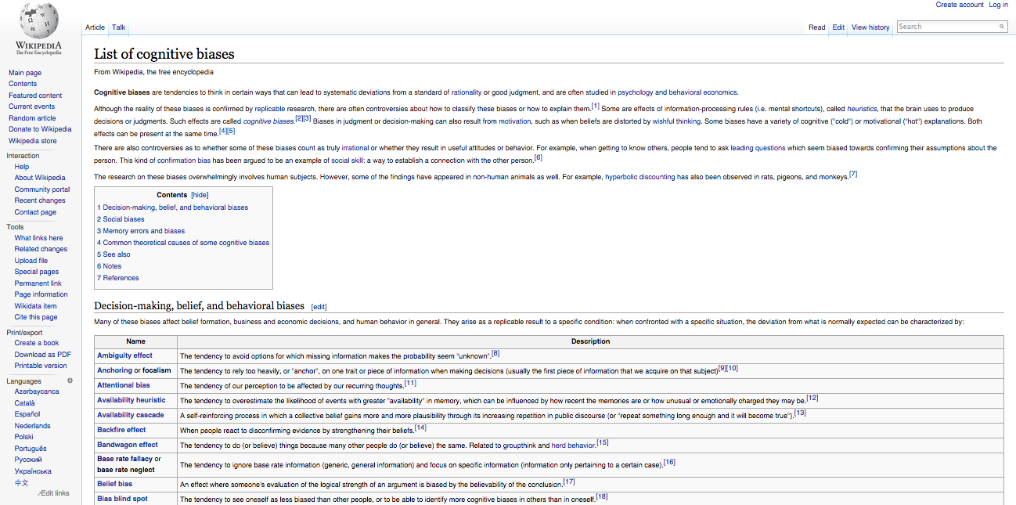
The Cognitive Bias Safari
89 and growing!!!

Slide 4
Two Ways Decision Analysts Deal with Biases
The easy way
Biases exist and are harmful
Decision analysis helps people overcome these biases
The hard way
Some biases can occur in the decision analysis process whenever a judgment is needed in the model and may distort the analysis
Need to understand and correct for these biases in decision analysis

Slide 5
Judgements in Modelling Uncertainty
Eliciting distributions
d₁
d₂
d_{M}
U₁
U₂
...
U_{M}
Identifying
Variables
U_{t}
Aggregating distributions
d_{Te}

Slide 6
Judgements in Modelling Values
Identifying objectives
Eliciting weights
O
w₁
w₂
w_{N}
O₁
O₂
O_{N}
Eliciting value functions
g₁
g₂
g_{N}
...
x₁
x₂
x_{N}
Defining attributes

Slide 7
Judgments in Modelling Choices
Identifying uncertainties
P_{1,1}
X_{1,1}
P_{1,2}
C₁
X_{1,2}
P_{1,k1}
...
a₁
X_{1, k1}
Identifying alternatives
P_{2,1}
X_{2, 1}
a₂
C₂
P_{2,2}
X_{2, 2}
D
P_{2, k2}
...
...
X_{2, k2}
Eliciting Probabilities
a_{Z}
P_{Z,1}
X_{Z, 1}
C_{Z}
P_{Z,2}
P_{Z, kZ}
X_{Z, 2}
...
Estimating
Consequences
X_{Z, kZ}

Slide 8
More vs Less Relevant Biases
More Relevant Biases
They occur in the tasks of eliciting inputs into a decision and risk analysis (DRA) model from experts and decision makers.
Thus they can significantly distort the results of an analysis.
Less Relevant Biases
They do not occur or can easily be avoided in the usual tasks of eliciting inputs for DRA

Slide 9
Relevant Cognitive Biases
Cognitive biases are distortions of judgments that violate a normative rules of probability or expected utility
Anchoring
Availability
Certainty effect
Equalizing bias
Gain-loss bias
Myopic problem representation
Omission bias
Overconfidence
Scaling biases
Splitting bias
Proxy bias
Range insensitivity bias

Slide 10
Motivational Biases
Motivational biases are distortions of judgments because of desires for specific outcomes, events, or actions
Affect-Influenced Bias
Confirmation bias
Undesirability of a negative event or outcome (precautionary thinking, pessimism)
Desirability of a positive event or outcome (wishful thinking, optimism)
Desirability of options or choices

Slide 11
Mapping Biases
P_{1,1}
X_{1,1}
P_{1,2}
C₁
X_{1,2}
Eliciting Probabilities
P_{1,k1}
...
a₁
X_{1, k1}
P_{2,1}
X_{2, 1}
Anchoring bias (C)
Availability bias (C)
Equalizing bias (C)
Gain-loss bias (C)
Overconfidence bias (C)
Splitting bias (C)
Affect-Influenced (M)
Confirmation bias (M)
Desirability biases (M)
a₂
C₂
P_{2,2}
D
X_{2, 2}
P_{2, k2}
...
...
X_{2, k2}
a_{Z}
P_{Z,1}
X_{Z, 1}
C_{Z}
P_{Z,2}
P_{Z, kZ}
X_{Z, 2}
...
X_{Z, kZ}

Slide 12
Debiasing
Older experimental literature shows low efficacy
Recent literature is more optimistic
Decision analysts have developed many (mostly untested) best practices, which we reviewed:
Prompting
Challenging
Counterfactuals
Hypothetical bets
Less bias prone techniques
Involving multiple experts or stakeholders

Slide 13
Our current research agenda
Few attempts of assessing the effectiveness of debiasing tools in controlled experiments
No previous attempt of assessing the effectiveness of sophisticated debiasing tools employed by decision analysts in practice
Aim: Create a research protocol for assessing debiasing tools employed in DRA practice.

Slide 14
Overconfidence
Bias: estimates are above the actual performance (overestimation) or the range of variation is too narrow (overprecision).
Evidence: Widespread occurrence in quantitative estimates (defense, legal, financial, and engineering decisions).
Debiasing Tools:
Probability training
Start with extreme estimates, avoid central tendency anchors
Use counterfactuals to challenge extremes
Use fixed-value elicitations

Slide 15
Debiasing Overconfidence: A Recent Behavioral Experiment
One hundred and ten undergraduate students (M_{age} = 21.6) from the Polytechnic University of Turin.
Elicited CDFs for 10 general questions (5 non-motivational and 5 motivational)
Participants were randomly assigned to one of the four conditions:
Fixed-Value vs Fixed-Probability Elicitation
Counterfactuals vs Hypothetical Bets
We incentivized accuracy using the Matheson and Winkler scoring rule

Slide 16
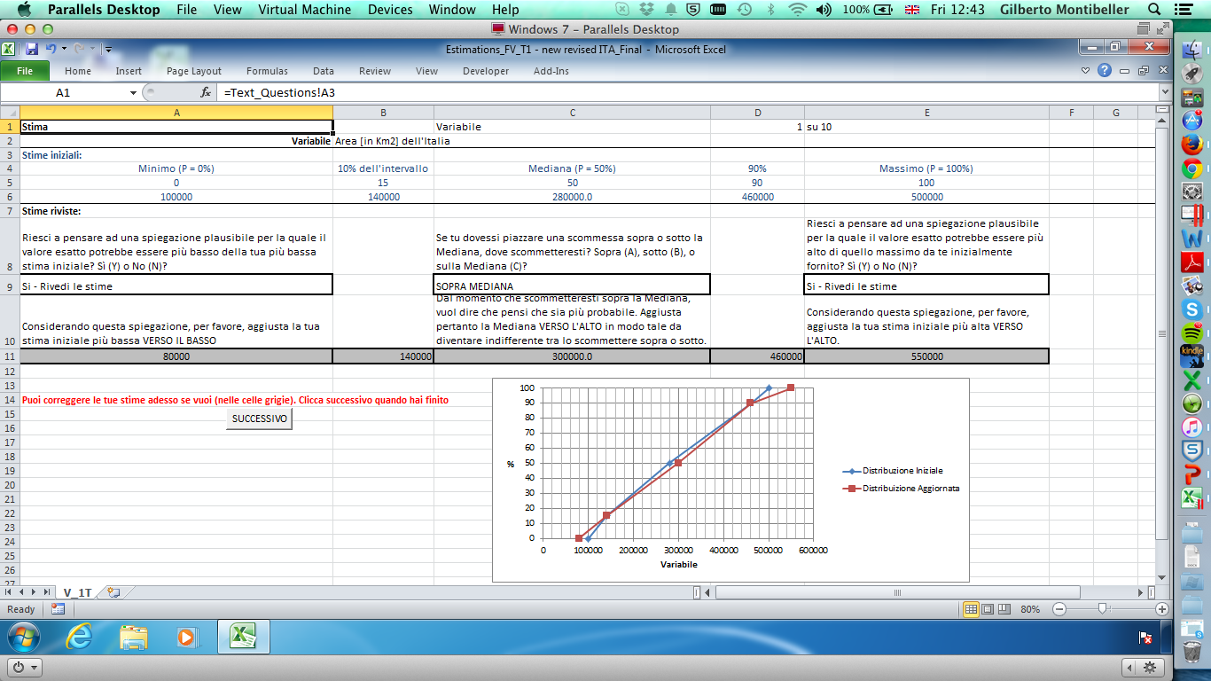

Slide 17
Interested on the Findings?

Slide 18
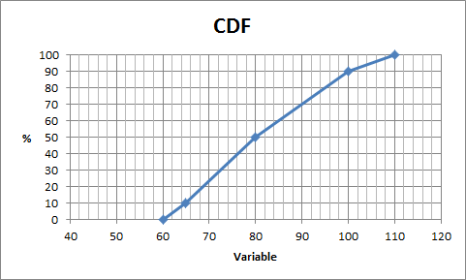
Eliciting a CDF – Fixed Value Method
Variable: Number of DAYS when ozone levels over an eight-hour period violated the federal standard in Southern California

Slide 19
Eliciting a CDF – Fixed Probability Method
Variable: Number of DAYS when ozone levels over an eight-hour period violated the federal standard in Southern California

Slide 20
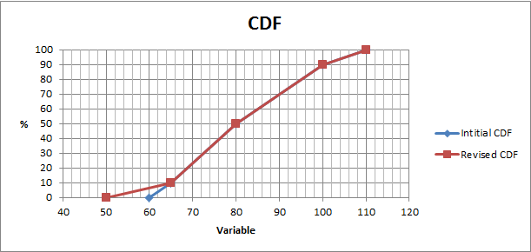
Stretching the Distributions - Counterfactuals
DA: Can you think about an explanation under which the true answer is lower than your initial lowest estimate? Yes (Y) or No (N)?
If YES, adjust the lowest estimate DOWNWARDS.
(The same protocol for the upper bound.)

Slide 21
Stretching the Distributions – Hypothetical Bet
DA: Consider a bet where you have to pay US$100 if the true value is below your initial estimate and receive US$1 otherwise. Would you take this bet, Yes (Y) or No (N)?
DA: If NO adjust the lowest estimate DOWNWARDS so you would take this bet.
(The same protocol for the upper bound.)

Slide 22
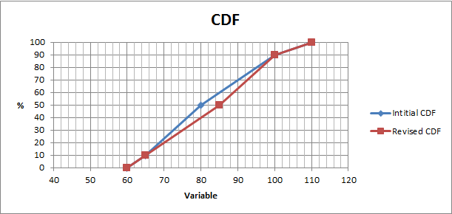
Calibrating the Median
DA: If you had to place a bet on either side of your Median (80 days), which side would you bet on, above, below, or at the Median?
Expert: Higher side
DA: Since you would bet on the higher side, adjust the Median UPWARD so that you would be indifferent between betting on the upper or lower side.

Slide 23
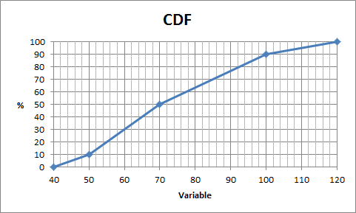
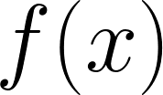
Accuracy of Judgments
True value: x_{t} = 88 days
Expert 1
Expert 2
x_{t} = 88
x_{t} = 88
Who provided a more accurate distribution?
Expert 1 (smaller area)
Matheson and Winkler Scoring Rule
Notes:
Latex:
S=\int_{0}^{x_t}\left ( f(x) \right )^2 dx +\int_{x_t}^{\infty}\left (1- f(x) \right )^2 dx

Slide 24
Conclusions
Relevant cognitive and motivational biases may significantly distort the decision analysis
We identified these biases for each modelling step in Risk and Decision Analysis
We are starting a program of evaluating the effectiveness of sophisticated debiasing tools employed by decision analysts

Slide 25
Thank you for your attention!
For more details:
Montibeller and von Winterfeldt (2015). Cognitive and Motivational Biases in Risk and Decision Analysis. Risk Analysis (forthcoming)
Ferretti, Guney, Montibeller and von Winterfeldt (2015). Testing Best Practices to Reduce the Overconfidence Bias in Multi-Criteria Decision Analysis. Proceedings of HICSS 2015 (under review).
Contact: Dr Gilberto Montibeller
Email: g.montibeller@lse.ac.uk

